Slide 1
TRAVEL SINGLE, NEVER ALONE
Presented by:
Agent Name
An Authorized SinglesCruise Representative

Slide 2
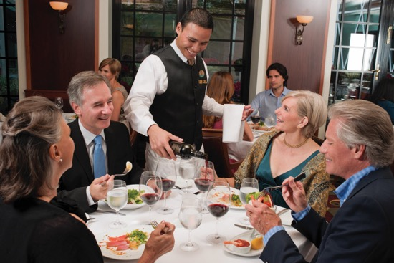
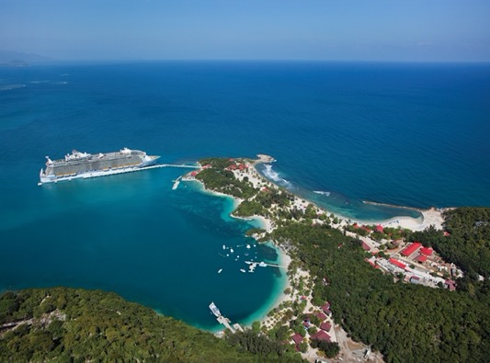
WHY A CRUISE VACATION?
You get a lot for your MONEY!
Superb dining with a wide variety of choices
Day and night entertainment & activities
Lodging and transportation to multiple destinations

Slide 3
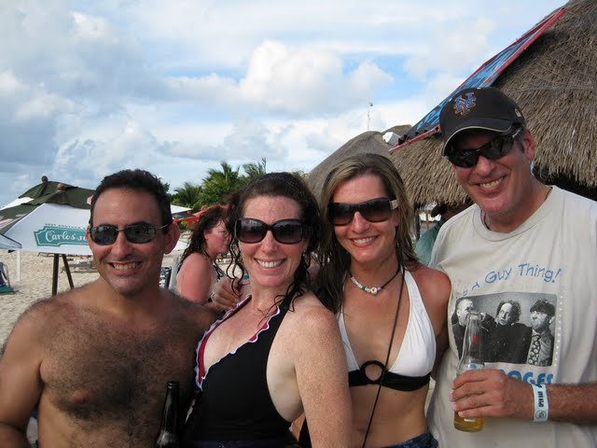
WHY A CRUISE VACATION?
You get a lot for your TIME!
No time wasted packing and unpacking
No “boring” road trips when you should be having fun
No figuring out how to meet others—it’s all taken care of for you

Slide 4
“BUT SINGLES ARE OFTEN LEFT OUT”
Cruises Aren’t “Built” for Singles …
Pricing is based on two people per stateroom, so singles pay more but don’t get anything extra
Activities are centered around couples and families
Few other singles onboard, so you’re often “on your own”
We didn’t think that was fair. Singles deserve to enjoy a cruise too!

Slide 5
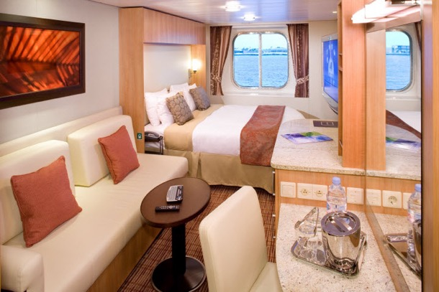
WHAT IS SINGLESCRUISE?
SinglesCruise organizes vacations for groups of singles — over 12 departures a year on multiple cruise lines
A full range of activities is included on each sailing to encourage mixing and
Dine together every night as a group
You can choose to cruise solo, with a friend or SinglesCruise can provide a roommate match

Slide 6
WHAT MAKES SINGLESCRUISE DIFFERENT?
This is not just a Cruise, it’s an Event …
You’ll feel like you “belong”
Our Hosts and veteran sailors welcome you
… with People Like You!
Interact with others before and after the cruise
Take it from our veterans – it’s not what you think, it’s even better!

Slide 7
A SINGLESCRUISE IS A TERIFFIC VALUE
Bring a Single Friend Along
No “risk” of the unknown
Lower cost by sharing a room
Roommate Matching
We’ll find a cabin mate for you from our other singles cruisers
Solo Travel that Makes Sense
30% of our guests sail solo
Even at a higher cost, cruises are a great value if you’re not “left out” of the fun

Slide 8
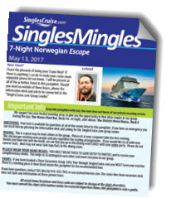
AT SINGLESCRUISE, WE GET SINGLES
Daytime Events: Dance Classes · Name That Tune · Trivia Games · Pizza Parties and more!
Theme Nights: Tropical Hawaiian · Angels & Devils Party · Karaoke Parties and more!
Other Singles Activities: Cocktail Parties/Mixers · Group Dining · Shore Excursions and more!

Slide 9
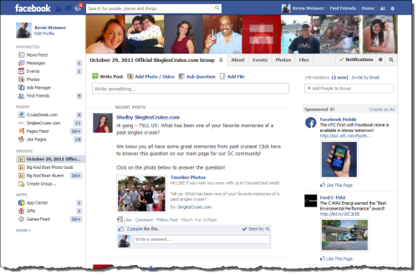
SINGLESCRUISE ONLINE COMMUNITY
Meet other singles before your trip in a Facebook group dedicated to your sailing
Post your cruise pictures during and after your trip
Share your memories and stay connected with new friends

Slide 10
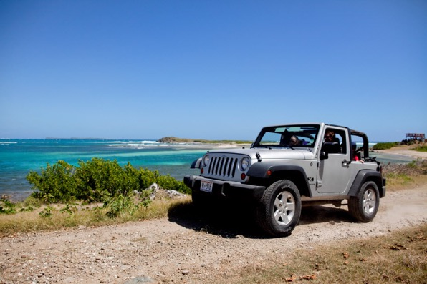
SINGLESCRUISE MAKES IT EASY!
As a full-service agency, we can help you with add-ons and extras for your trip, such as:
Pre- and post-cruise hotels or transfers
Additional shore excursions as tours

Slide 11
SINGLESCRUISE FAQ’S ANSWERED
How many people are in a group? It can range from 30 – 350, but 100 is average.
How old are SinglesCruisers? The majority are 35 – 55 but can range from 21 – 70+.
What’s the male to female ratio? It’s close to 50/50 on most trips.
Why is the price less if I buy through the cruise line directly? That’s a cruise where you’ll be paying a single supplement AND feel ”left out”. SinglesCruise provides events, including mixers, games and more, designed to make you feel like you belong onboard.
So is this all about ”hooking up”? Our goal is to bring people in the single lifestyle together to enjoy what a cruise has to offer and feel included.

Slide 12
SINGLESCRUISE FAQ’S ANSWERED
How does roommate matching work? Cruisers are matched by gender and we try our best to match close to age.
We only match non-smokers and cruisers in the correct age range for “age-designated” events.
If you don’t find a roommate for me, will I be charged more? No! Your price is guaranteed.
When will I learn who my roommate is? Roughly 30 days prior to sailing. We do not give our personal information for security and safety.

Slide 13
BOOKING A SINGLESCRUISE
Deposits vary based on cruise line promotions, stateroom and occupancy type at the time of booking
Final payment is generally due 90 days prior to sailing

Slide 14
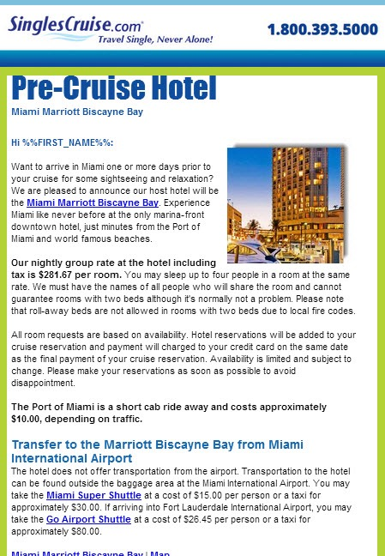
LEADING UP TO YOUR SINGLESCRUISE, YOU’LL RECEIVE VIA EMAIL …
Facebook Group invitation
Pre-cruise hotel and meet up details
Shore excursions
Theme nights, so you can pack appropriately!
Confirmation and online check-in instructions
Orientation party time and location
SinglesMingles, your daily program of events!

Slide 15
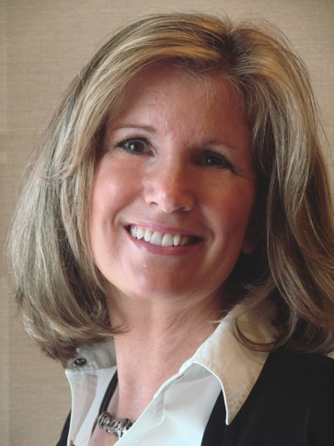
HOW CAN I HELP YOU?
Authorized SinglesCruise Representative
I’ll make your booking and answer questions
I can help with air tickets if you need
You won’t get a lower price anywhere else
Agent Name
Agent Email
Agent Phone

